Slide 1

Name:
Arash Harirpoosh
Student Number:
9731505
Presentation Title:
MQTT packet

Slide 2
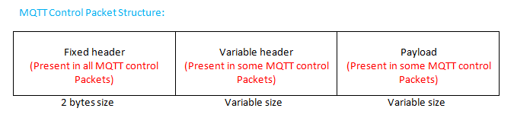
MQTT Packet Structure
Consists of three fields:
Fixed Header
Present in all packet and the size is 2 bytes.
Variable Header
Has Variable size and no present in all packets
Payload
Has Variable size and no present in all packet

Slide 3
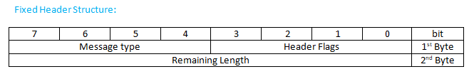
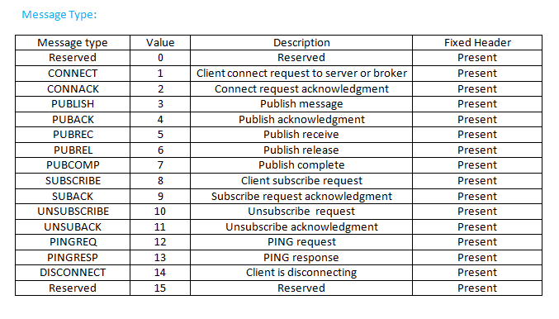
MQTT Packet Structure
Fixed Header:
Message Type
Represents a connection request type
Each value of message type represents different connection request
4 bit in length
Header Flags
Remaining Length

Slide 4
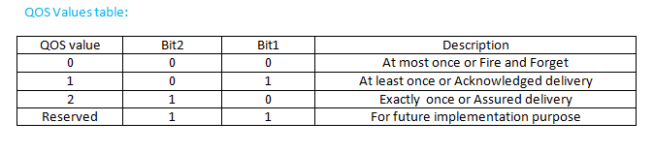
MQTT Packet Structure
Fixed Header:
Message Type
Header Flags
DUP: duplicate delivery of publish control packet.
DUP=0
This is the first attempt of Clients to send MQTT publish control packet.
DUP=1
Client is again trying to send previously sent packet.
QOS: Quality of service
Its 2 bit in length and indicates the assurance of message delivery
Remaining Length

Slide 5
MQTT Packet Structure
Fixed Header:
Message Type
Header Flags
RETAIN:
RETAIN=1 means Broker or server will hold or store the packet unless there no subscriber with same topic as topic in stored packet
As soon as there is subscriber , Broker will deliver the stored packet.
RETAIN=0 means broker will not hold the packet.
Remaining Length
Number of bytes left within current packet, including variable header plus payload.

Slide 6
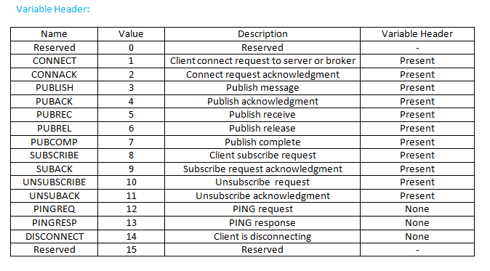
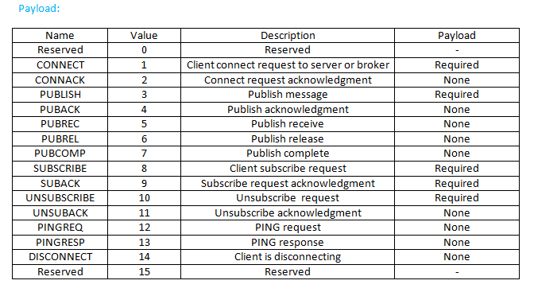
MQTT Packet Structure
Variable Header:
Not present in all MQTT control packets
Different structure for different MQTT request
Payload:
Actual data which is to be send
Not present in all MQTT control packets

Slide 7
References
https://bytesofgigabytes.com/mqtt/mqtt-protocol-packet-structure/

